Slide 1
APA PRIVATE PRACTICE DIVISION 2023 ANNUAL MEETING
September 29, 2023

Slide 2
AGENDA
Introductions
PPD Status Report
PPD IN 2023 – 2024
APA & PPD INITIATIVES
DISCUSSION
What Have We Learned?
Where Should We Go?

Slide 3
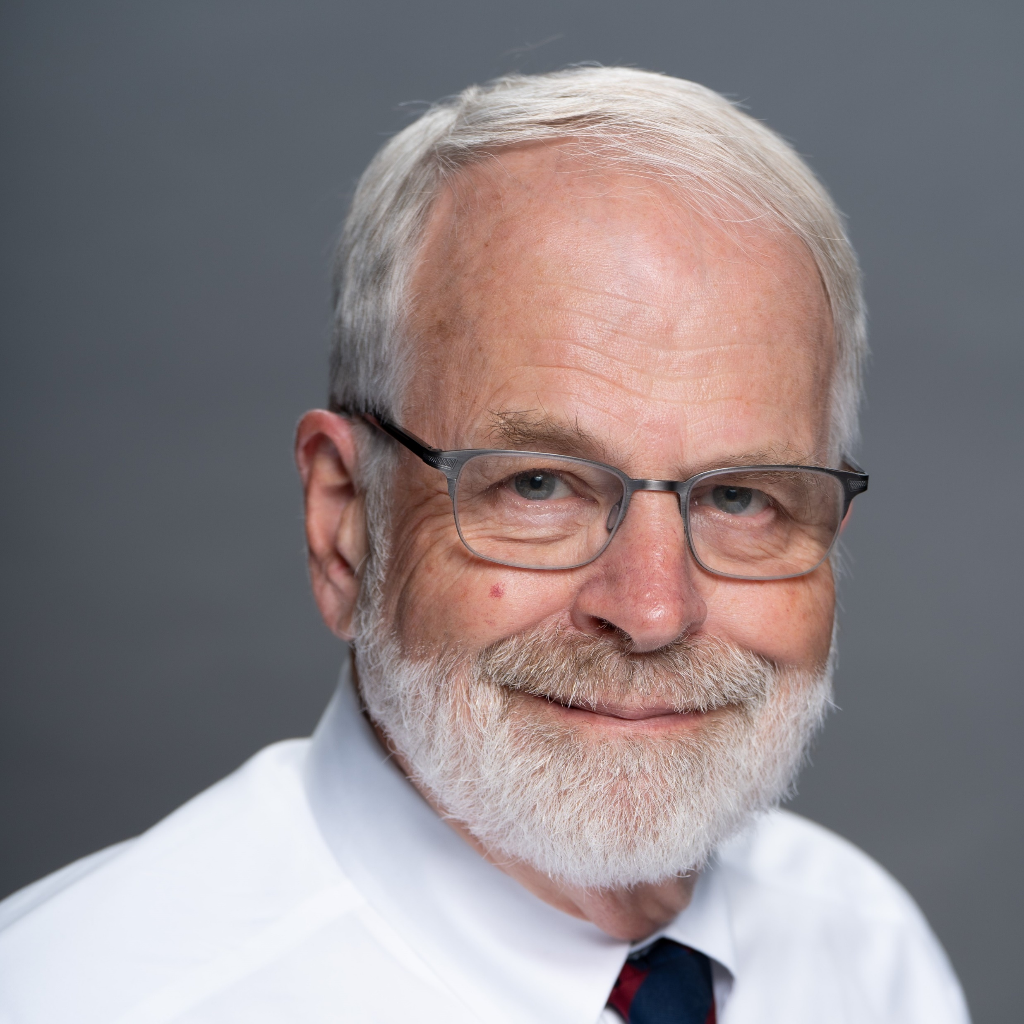
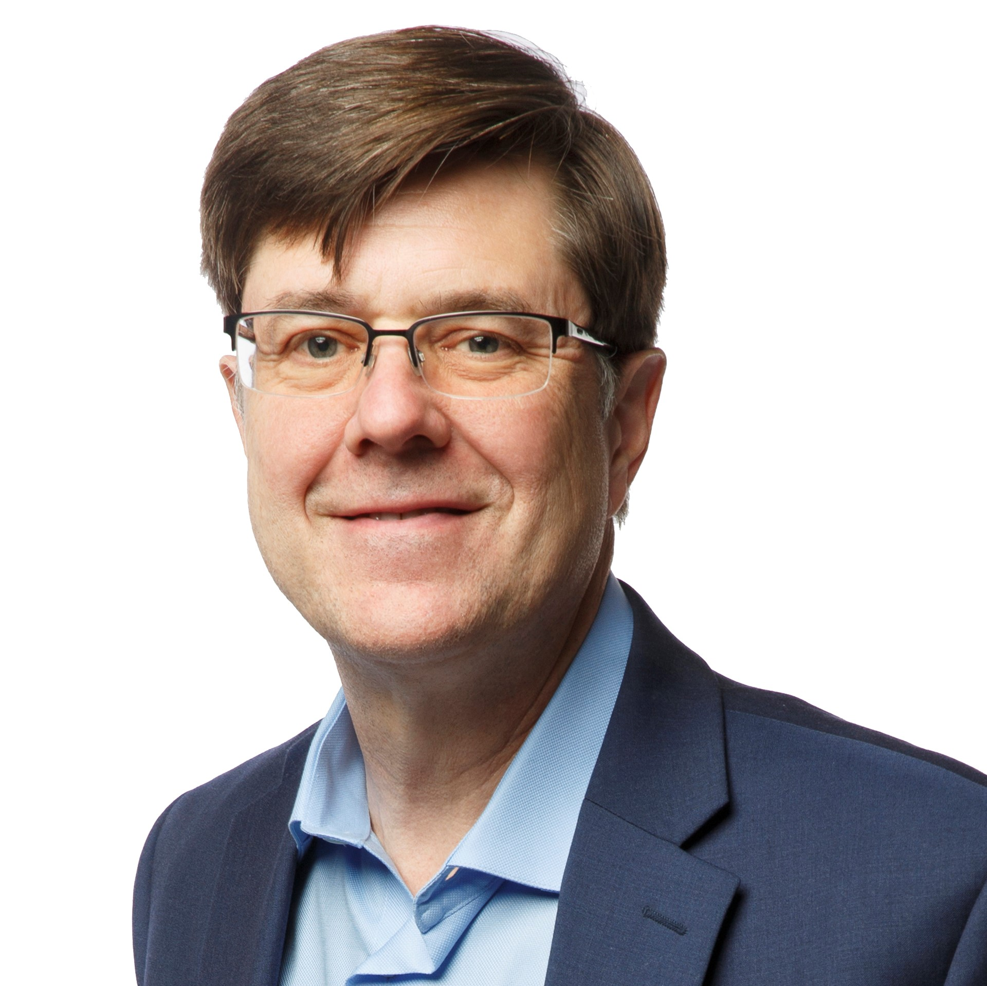
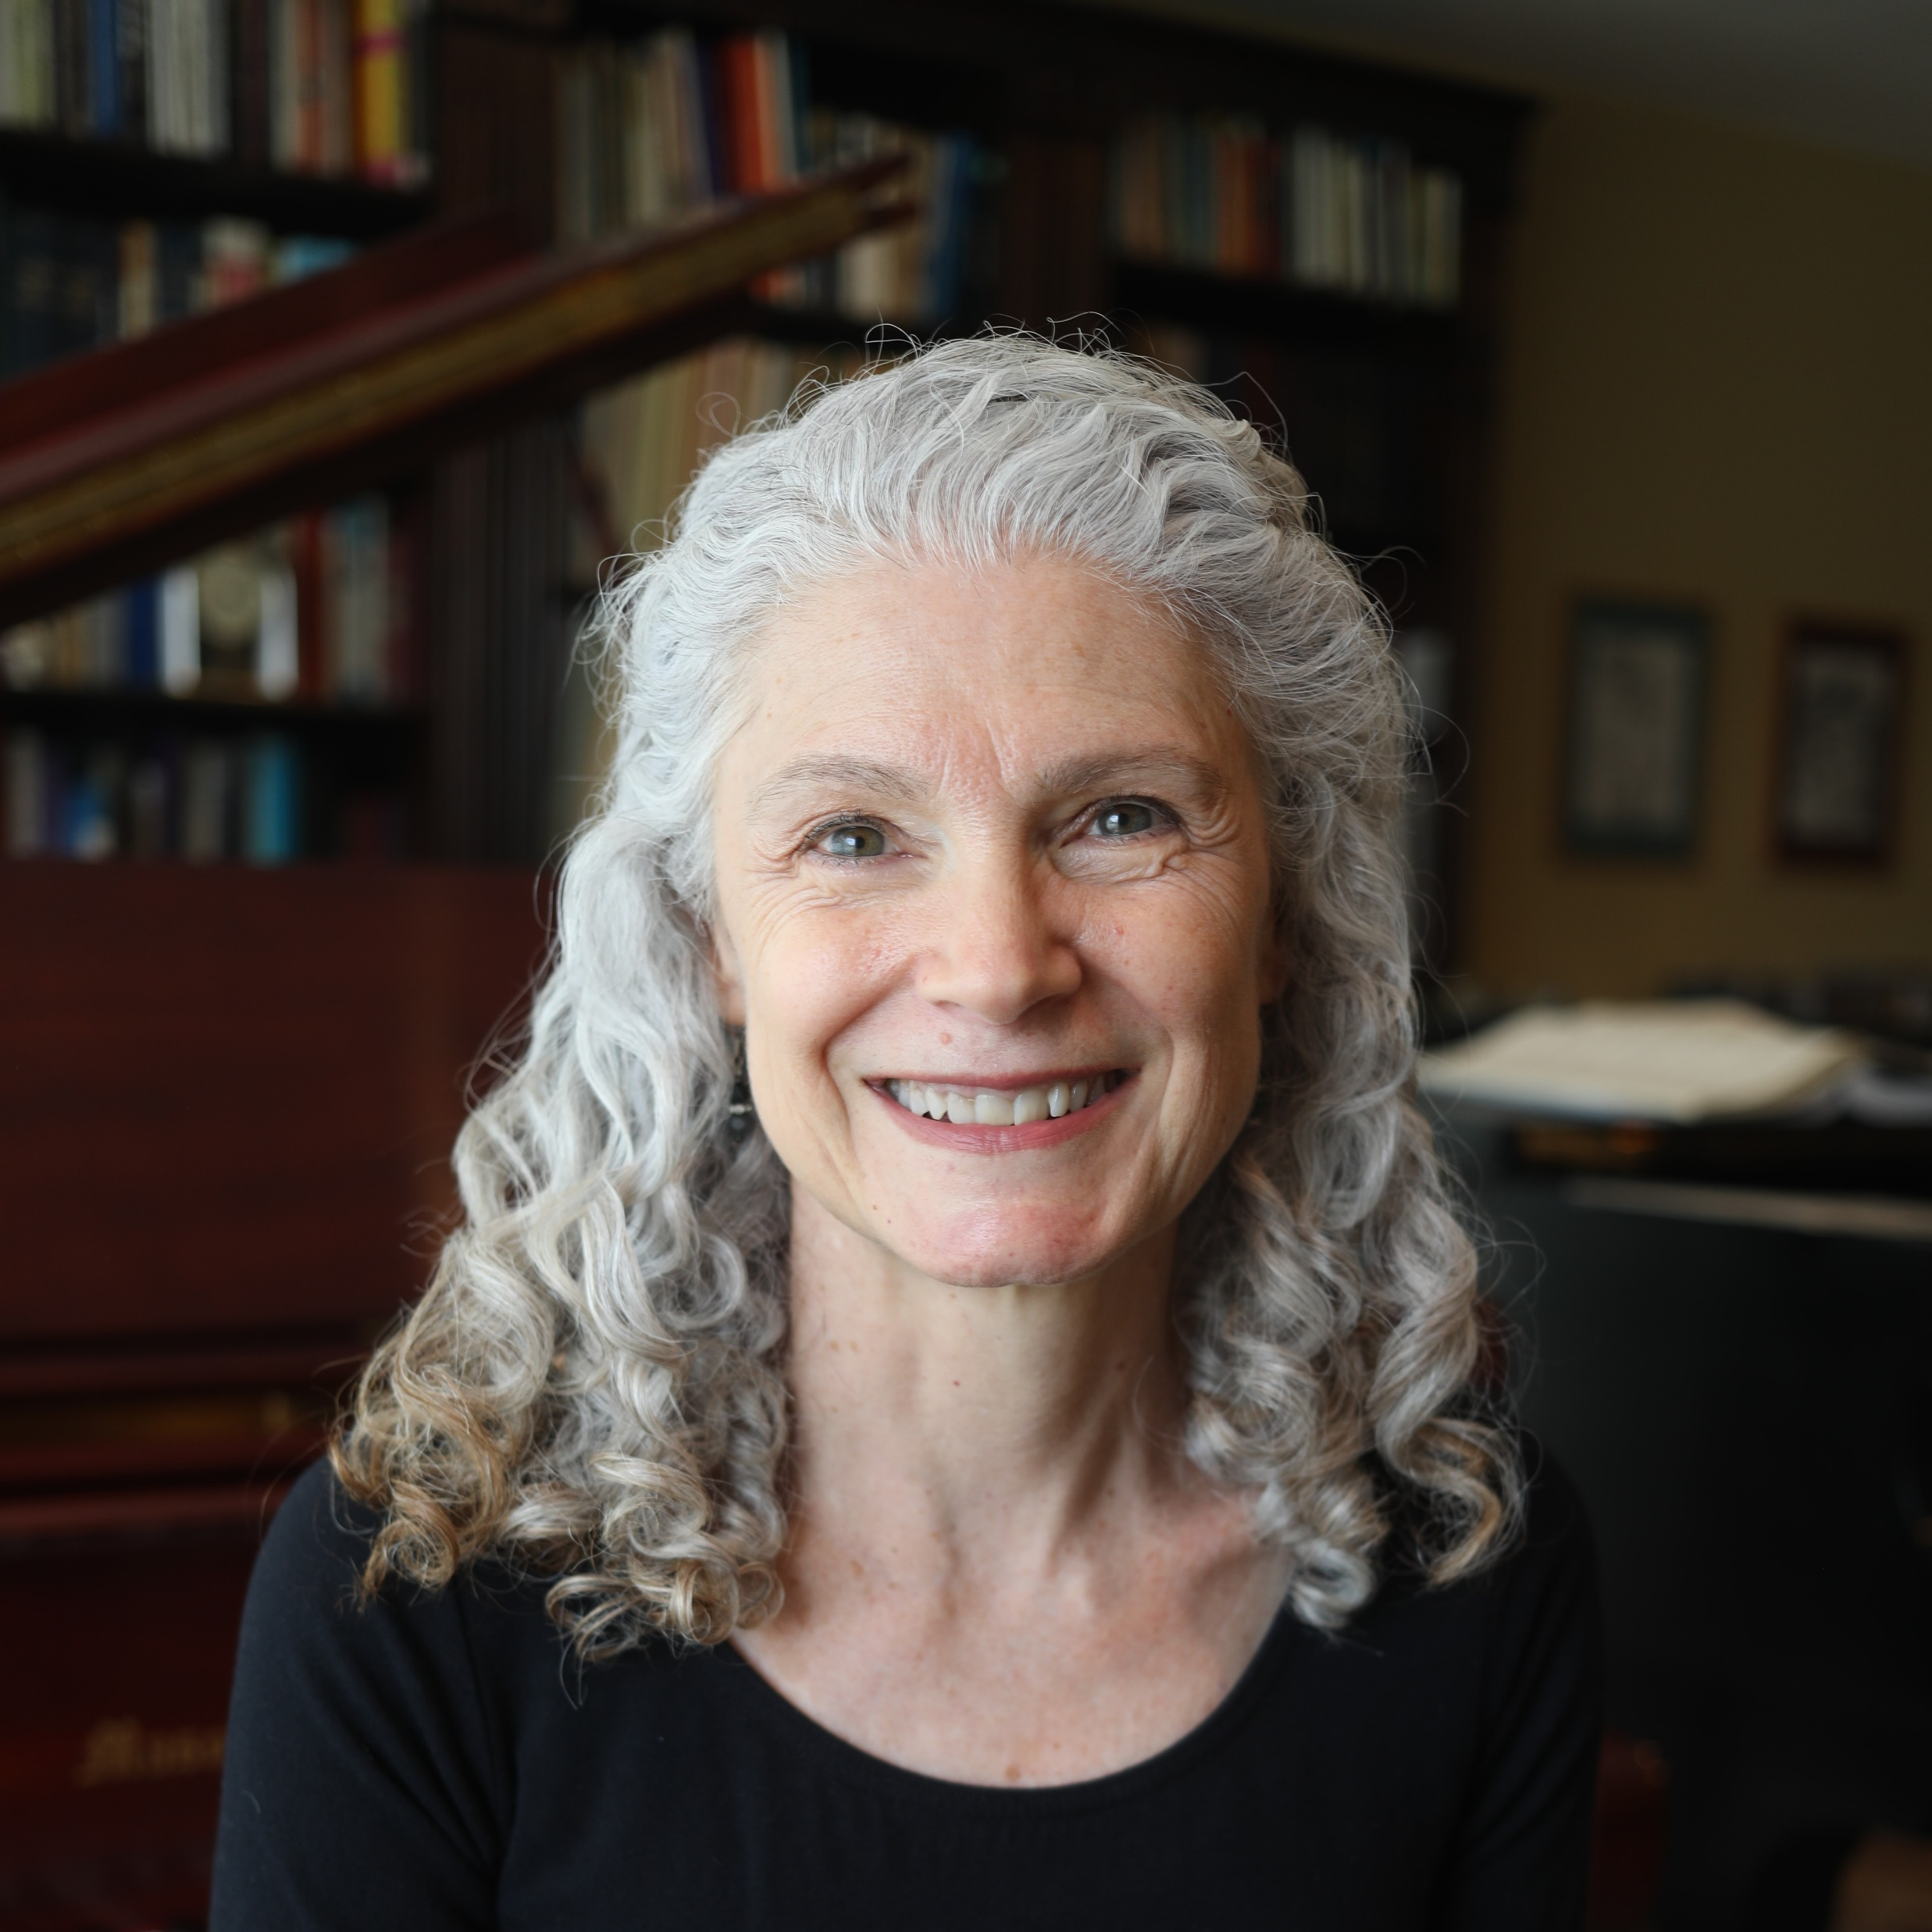
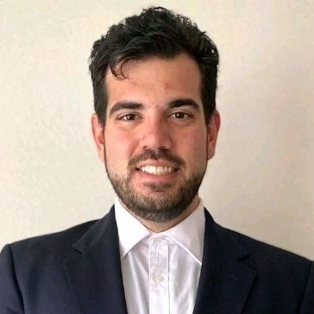
PPD Executive Committee 2023
Stephen Tocknell
Chair
Liz Schultz
Finance Chair
Brad Strader
Vice Chair
Wendy Talio
Communications Chair
Deana Rhodeside
Past Chair
Armin Aryafar
Student Representative

Slide 4
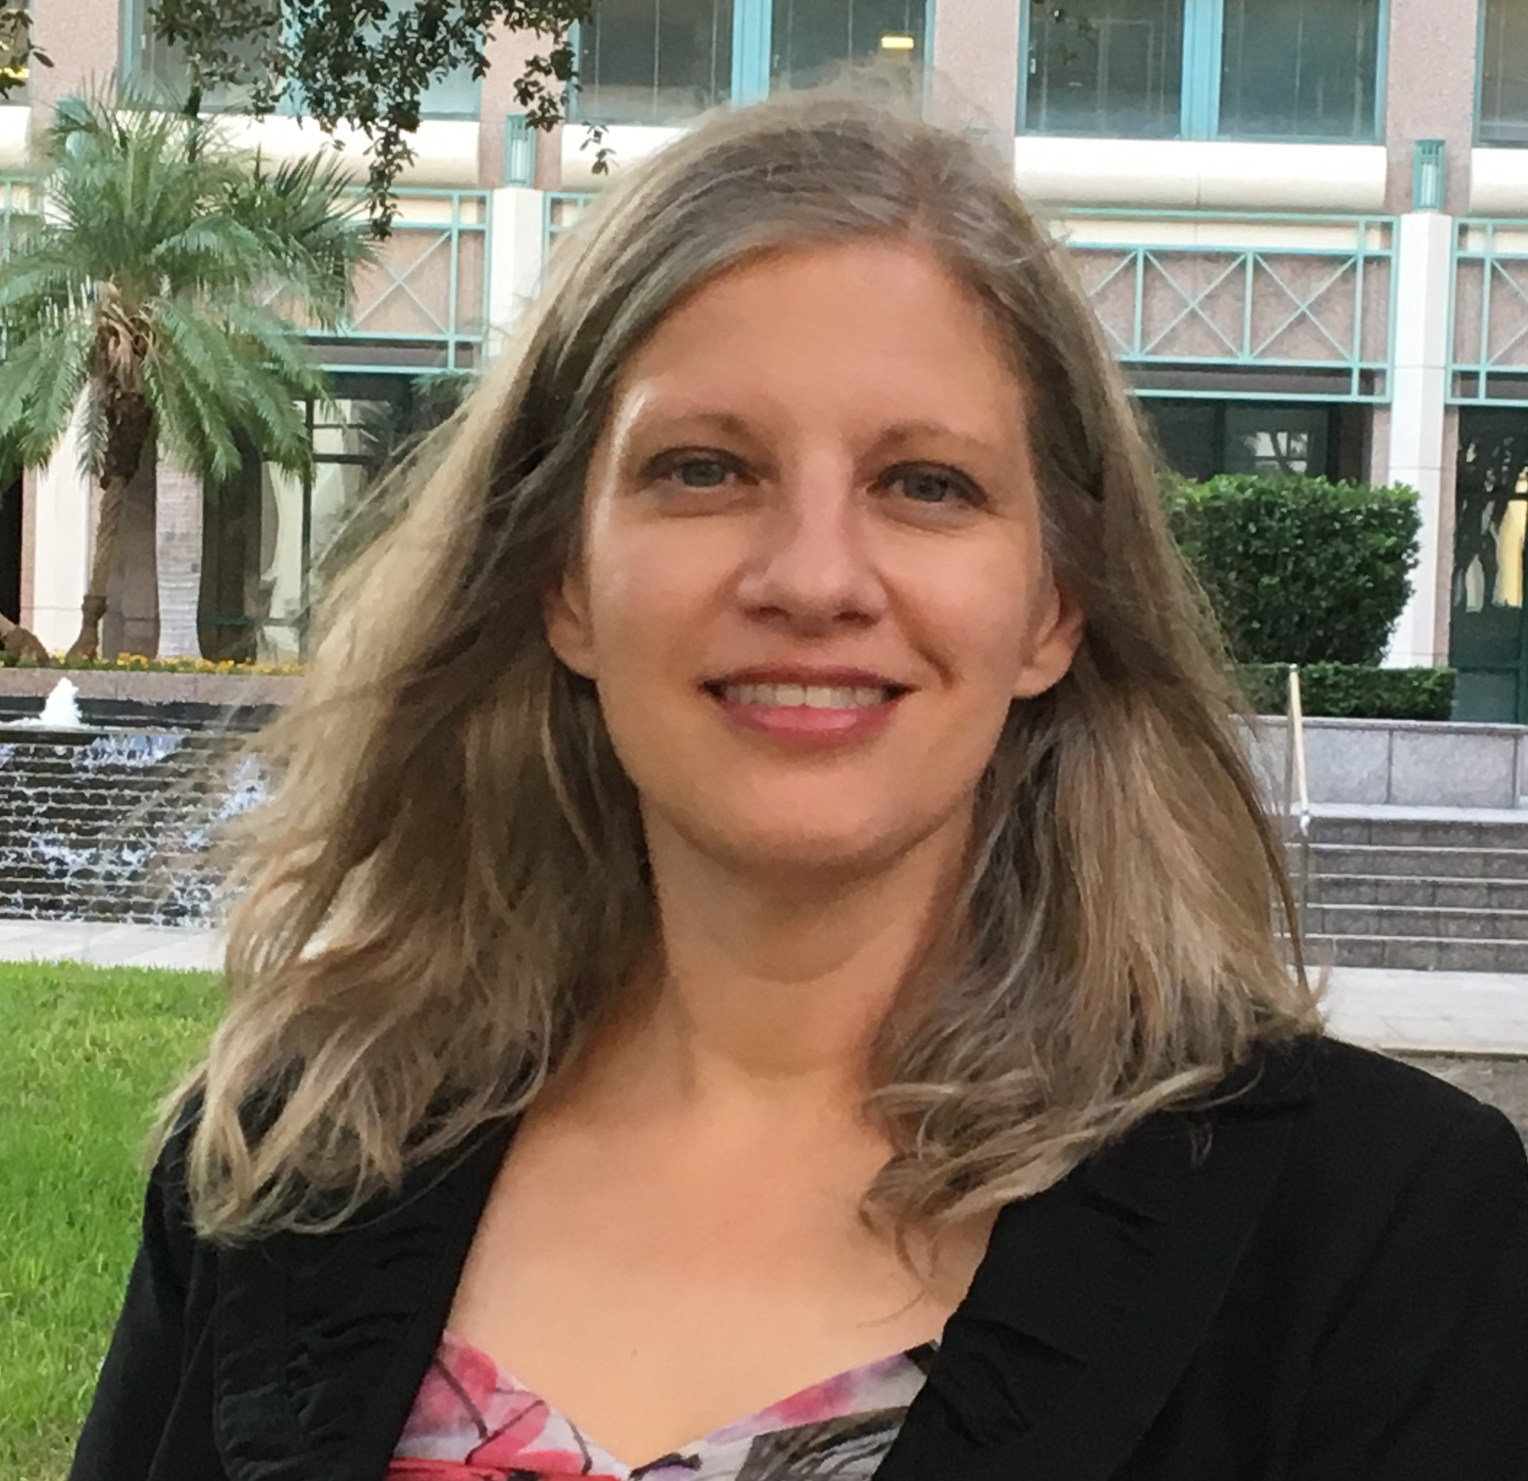
PPD Executive Committee 2024-2025
Stephen Tocknell
Chair
Deana Rhodeside
Past Chair
Brad Strader
Vice Chair
Armin Aryafar
Student Representative
Alissa Barber Torres
Secretary Treasurer
???
New Members
To Be Appointed

Slide 5
APA PRIVATE PRACTICE DIVISION 2023 STATUS REPORT

Slide 6
DIVISION MEMBERSHIP 2019 - 2023
SETEMBER MEMBER ROSTERS
Total Membership
2019: 1,034
2023: 724
Student Membership
2019: 713
2023: 129
Non Student Membership
2019: 321
2023: 337
Total Membership
Non Student Membership
*Total includes APA Staff

Slide 7
PPD Financial Report
Through August 2023
 | FY 2023 Budget | Through August 2023
Opening Balance | $ 16,655
Revenue
Membership Dues | $ 3,088 | $ 2,066
Other Revenue | $ 2,300 | $ 375
Total Revenue | $ 5,388 | $ 2,441
Expenses
Communications | $ 1,260 | $ 362
APA Conference | $ 1,500 | $ 1,651
Travel for Chair | $ 1,684 | $ 1,652
Education | $ 690 | $ 245
Membership and Outreach | $ 2,315 | $ -
Total Expenses | $ 7,449 | $ 3,910
Net Revenue-Expenses | $ (2,061) | $ (1,469)
Closing Balance | $ 14,594 | $ 15,186
BUDGET

Slide 8
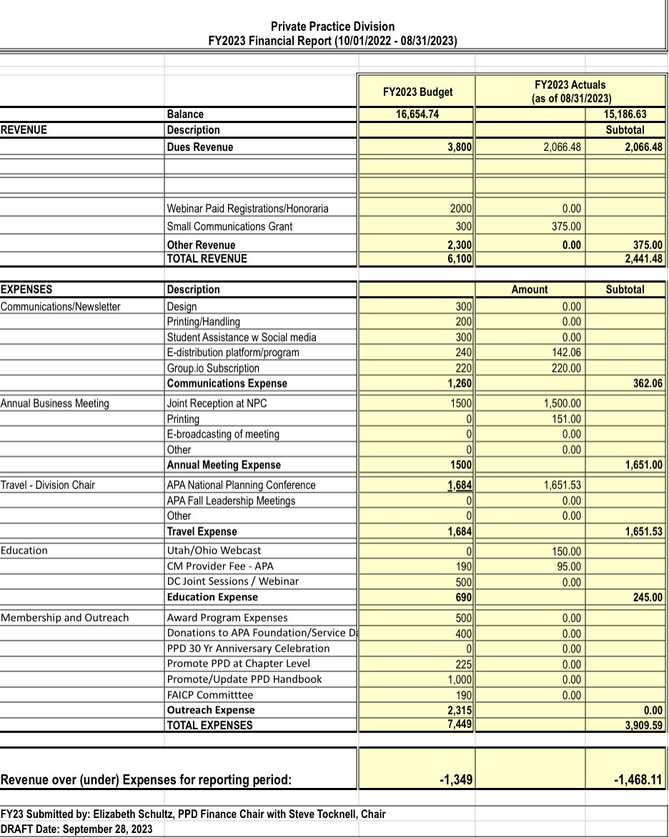
BUDGET

Slide 9
2022 Member Survey RECAP
OVERVIEW
FOCUS
Grow Membership
Improve Benefits
Students & Practitioners
Small number of responders...
40 responses, No Students
...but representative of who is engaged
90% Private Sector
83% Planners, Architects or Engineers
82% Planning 11+ years in the profession
65% Sole Proprietor or < 10 Employees
Member priorities consistent with last survey
Developmental Resources, Skill Building, Networking, Promote Value

Slide 10
2022 Member Survey RECAP
IMPROVE BENEFITS
Increase Networking Opportunities
Leverage Group.io
National Conference
Ramp up Linked In Group
Regional Meetups
Developmental Resources
Revised Handbook
Content Rich Website
Mentorship Program
Opportunities to Address “Hot Topics”
Webinars
PPD Conversations
National Conference Sessions
FOCUS
Network
Resources
Relevance

Slide 11
2022 Member Survey RECAP
GROW MEMBERSHIP
Raise Awareness
Conferences
Campus Presence
Engage
Website Content
Newsletter Sign Up
Join
Onboarding Communication Stream
Encourage Use of Benefits
Retain
Promote volunteerism
Continuous Feedback and Improvements
Implement a Marketing Communication Strategy

Slide 12
Communications Committee
Implementation Team
Focus
Sustainable Membership Needs A Sustained Support Team
The Private Practice Division Communications Committee (PPD-CC) is responsible for creating and maintaining all touchpoints with members.
Driven by a defined Communication Strategy the PPD-CC builds awareness of the Division’s offerings, to grow and sustain membership, ensure regular and transparent communication between the Board and the members, and to encourage member-to-member network connections.
Alissa Torres – Interim Chair
Corey Hull – Email, Website, LinkedIn Admin
Armin Aryafar – Student Engagement, Survey
Help Wanted!
Onboarding Manager
Newsletter Editor and Contributors
Guest Speaker Coordinator for Conversations
Content Calendar Manager
Group.io Admin

Slide 13
2023 student Member Survey
Overview
Focus
General Planning
Real Estate
Transportation
Survey Response
9 responders out of 120 Student members invited
Conducted informal interviews at FAPA due to low survey response
Student Member Profile
Majority of respondents are earning a masters degree full time
Majority are interested in networking and real-world Private Practice experiences
Majority use Linked In as the primary source of Networking
Student Member priorities
Software workshops and mentorship programs as well as internship placement assistance
Student respondent quote: “You really need to put a program together that talks about the difference[s that] universities [have] and the planning degrees they offer.”

Slide 14
2023 student Member Survey
Next Steps?
Focus
Real Life Student/Member Interactions
2024 Survey
Meet students where they are (i.e., at conferences, universities and other student centric forums)
Focus on the disconnect between planning theory and planning real life practice
Informal Interviews
Added more credibility to the limited survey as students responded similarly to the survey
Live engagement is key

Slide 15
PPD IN 2023 - 2024
Looking Back – Looking Forward

Slide 16
Private Practice Handbook Update
2023: FINALIZING AND PRODUCING THE UPDATED HANDBOOK
Completion of edits and updates to all existing chapters
Major revisions to Chapter 3 (Marketing) and Chapter 4 (Pursuing Work and Securing Contracts)
New Format
Availability: October 2023 (Stay tuned for the availability announcement!)
Will remain a PPD members-only benefit

Slide 17
Communications
2023
Defined membership growth communication strategy
Website Redesign (Implementation in progress)
Student Survey
Monthly Chat (Letter from the Chair)
Event Announcements
Group.io reboot
2024
Establish Communications Committee
Regular Content Updates through all channels
Student Outreach

Slide 18
Conversations
FY 2023
October 28 2022 PPD – Past Present and Future
December 1 2022 Liability, Indemnification and Insurance
January 27 2023 Infrastructure Investment and Jobs Act
February 24 2023 Insurance Questions and Concerns
April 28 2023 Protecting Planners From Sexual Harassment
June 23 2023 Four Stages of Professional Development
September 22 2023 Writing a Better RFP (Webinar)
Upcoming
October 27 2023 Prime – Sub Partnerships
December 1 2023 Overview of 2023 Private Practice Handbook

Slide 19
PPD at National Planning Conference
NPC 23 – Philadelphia (April 1 - April 4, 2023)
Career Development Presentation
Joint Reception with TPD
Exhibit Hall Meet and Greet
NPC 24 – Minneapolis (April 13 – April 16, 2024)
Joint Reception with ?
Better Use of Exhibit Hall Space
Promote Sessions Led by PPD Members

Slide 20
APA & PPD initiatives

Slide 21
apa initiatives for 2024
Prioritize Equity
Voice of Planning
Digital Relevance
Enhance Events
Housing Advocacy
New Division Membership
Welcoming Environment

Slide 22
Proposed ppd initiatives
Communications strategy
Student outreach
Professional development
Supportive workplaces (EDI)
liability insurance through apa national
Mentor program
PPD Sponsorships
Awards?

Slide 23
Discussion:
What have we learned?
Where should we go?

